Slide 1

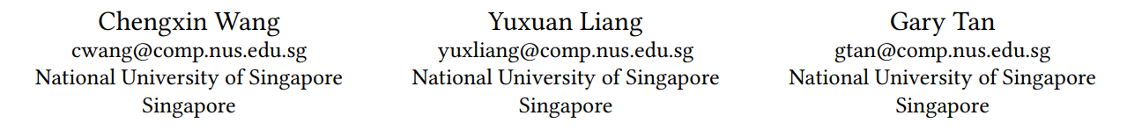
Periodic Residual Learning for Crowd Flow Forecasting
In The 30th International Conference on Advances in Geographic Information Systems (SIGSPATIAL ’22), November 1–4, 2022, Seattle, WA, USA. ACM, New York, NY, USA.

Slide 2
INTRODUCTION
-------------------------------------------------------------------------

Slide 3
Introduction
Nowadays, the development of intelligent transportation systems has drawn increasing attention as the number of vehicles grows over the years. The total number of motor vehicles has reached 273 million in the U.S. , and 6.08 million in Beijing by 2018, respectively, and it has grown to 6570 thousand in Beijing by 2020 .

Slide 4
Goal
To manage citywide transportation more efficiently, crowd forecasting aims to divide a city into multiple regions, i.e., even grid cells, and generate future vehicles’ in/out-flow for each region (such as: assisting transportation managers to alleviate the congestion , guiding carsharing companies to pre-allocate vehicles and helping travelers’ decision-making) .
Spatio-temporal (ST) dependency is an important characteristic in crowd flow forecasting: one region’s future crowd flow volume is conditioned on other regions’ histories and its historical observations.

Slide 5
Mainstream works
Mainstream works employ convolutional neural networks (CNNs) to capture spatial correlations and utilize different sub-branches or channels to model temporal dependencies of different time scales.
Besides, there are some methods that adopt recurrent neural networks (RNNs) or Transformer to enhance temporal modeling via recurrent state transformations or attention mechanisms. - However, these models always require higher computational costs and larger storage compared to their CNN counterparts.
Meanwhile, more recent works suggest that CNNs can effectively model the spatial and channel-wise correlations simultaneously with the Squeeze-and-Excitation (SE) mechanism .

Slide 6
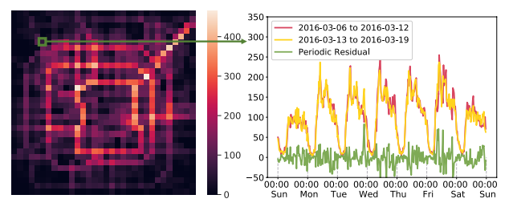
A visualization of crowd flows
Left hand side: the city is divided into many regions;
right hand side: the crowd inflow of a region during a period of two weeks, i.e.,
from 06 March 2016 to 19 March 2016.
Figure.1

Slide 7
Periodicity
Another key characteristic in citywide crowd flow is periodicity . As can be observed from Fig. 1, crowd flow data show periodic patterns, e.g., daily and weekly.
For instance,
- on the daily scale, the volume in the region follows a similar trend that increases during the morning and decreases during the night;
- on the weekly scale, the flow pattern trends to repeat every week (see the red and yellow line).

Slide 8
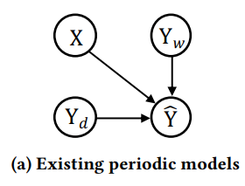
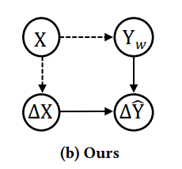
Periodic models
Figure 2: Graphical models for periodic modeling, where X and Yˆ represent the current segment and the target segment, respectively.
Y𝑑 and Y𝑤 denote segments for the daily scale and the weekly scale, respectively.
The solid line indicates the direct relationship, and the dashed line denotes the indirect relationship.
Figure.2
Figure.2

Slide 9
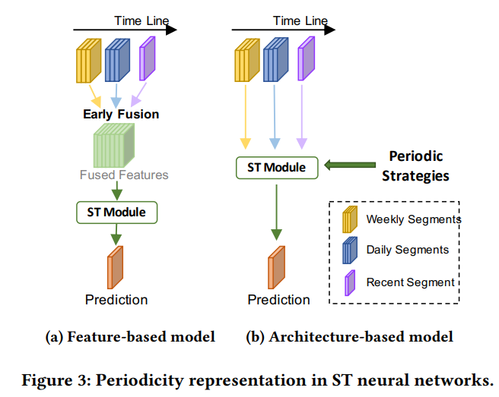
Model representation
As shown in Fig. 3 (a), the feature-based models view the multi-scale observations as different features and concatenate them as a tensor for the network to process.
However, the periodic information is mixed in the early stage, while being eliminated as the network depth increases. To tackle this issue, the architecture-based models represent the periodicity more naturally via some extra periodic strategies (see Fig. 3 (b)).

Slide 10

Model Comparison
DeepST introduces different branches to capture the periodicity.
Periodic-CRN designs a loop-back mechanism to integrate the recurrent periodic representations.
STDN utilizes the attention mechanism to calculate the similarity of ST representations between multi-scale segments.
High computational
Extra parameters

Slide 11
Solution
we first investigate the inherent periodic behavior of crowd data:
As shown in Fig. 1, though the daily crowd flow often fluctuates, the volume difference of a certain region at the same time in successive weeks (we term it as periodic residual) tends to be stable even in long-term trends (see the green line).
As opposed to raw crowd flow data, periodic residual holds clearer patterns that are easier to learn and can help to reduce the difficulties in modeling complex crowd flow patterns.

Slide 12
PRNET
we present a novel architecture-based framework entitled Periodic Residual Network (PRNet) for multi-step ahead crowd flow forecasting:
- Instead of designing complex ST extraction models or sophisticated periodic strategies, PRNet focuses on learning periodic residuals.
- As depicted in Fig. 2 (b), PRNet converts the learning focus from directly generating predictions to computing the periodic residual.

Slide 13
FORMULATION
Definition1 ~ Definition 5

Slide 14
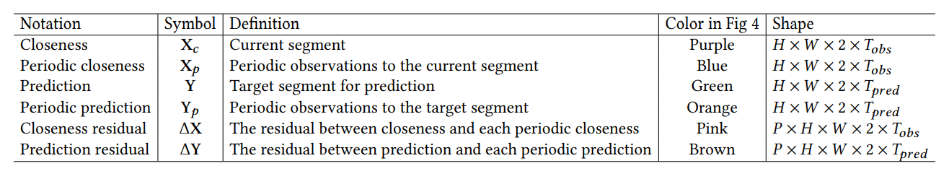
Notations
Table 1: The notations of crowd flow, where 𝑃 refers to the total number of selected periods and 𝑝 is the periodic index.

Slide 15

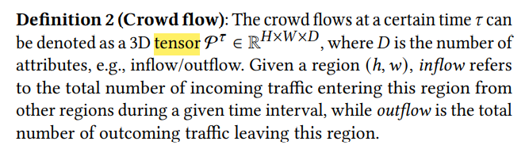
Definition(1,2)

Slide 16
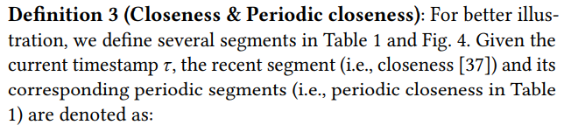
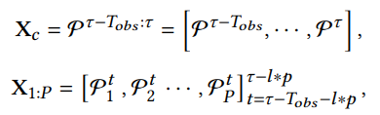

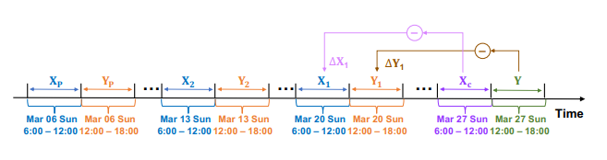
Definition(3)
Fig.4

Slide 17
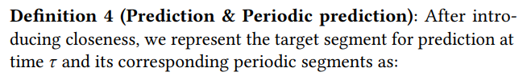
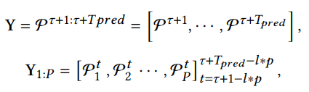
Definition(4)
Fig.4

Slide 18
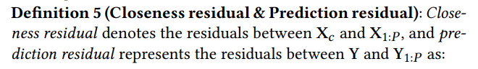
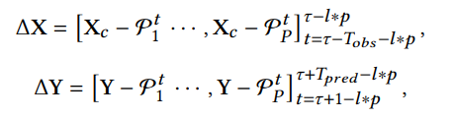
Definition(5)
Fig.4

Slide 19
ARCHITECTURE
PERIODIC RESIDUAL LEARNING
Notes:
https://github.com/scikit-mobility/DeepLearning4HumanMobility/blob/master/Tasks/crowd.md

Slide 20
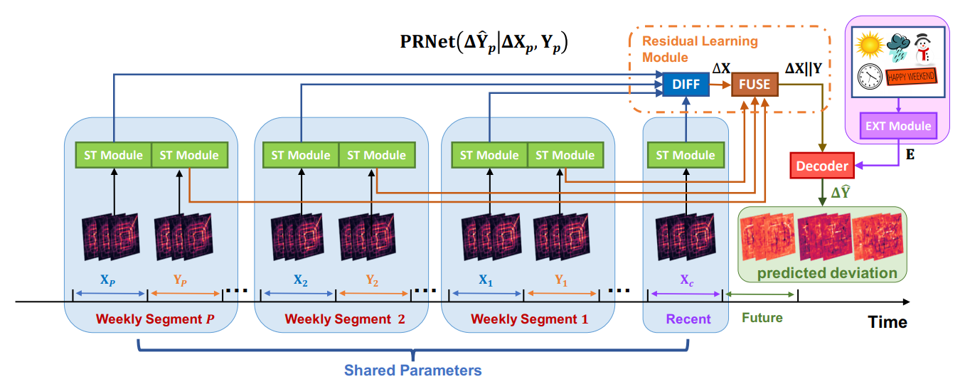
Overview
Figure 5: The overview of PRNet, where ST Module captures the ST correlations of each observed segment simultaneously. Then the network employs a differencing function (DIFF) to provide the closeness residual, and a fusion function (FUSE) to generate representations for the prediction residual. The decoder generates predicted deviations for all periodical weeks.

Slide 21
PR Learning
With the Fig.5 structure, PRNet reduces the data non-stationary by utilizing the closeness residual to assist prediction residual generation.
For each segment (i.e., closeness, periodic closeness, and periodic prediction), we first fed the raw inputs to the shared ST Module for spatio-temporal representation.
Once we obtain the high-level features for each segment, we utilize a Residual Learning Module to learn prediction residual features.
The details of PRNet will be elaborated in the following sections: - ST Module
- Residual Learning Module

Slide 22

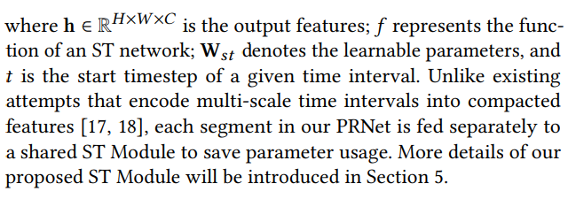
ST Module
In PRNet, ST Module extracts high-level spatio-temporal representations (denoted as h) for each segment via the ST network:

Slide 23
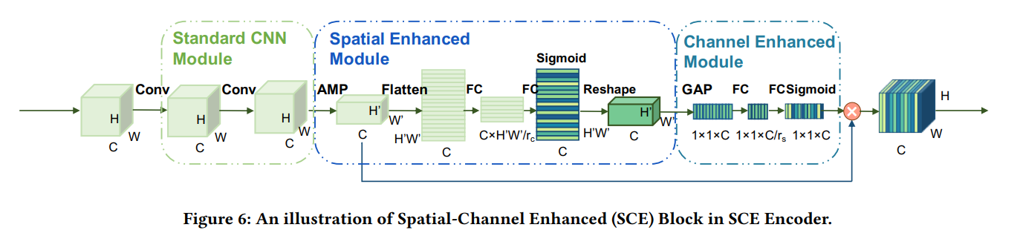
Spatial-Channel Enhanced (SCE)
In Fig. 6, we illustrate a single SCE block in SCE Encoder. It comprises three main modules:
- Standard CNN Module, Spatial Enhanced Module, and Channel Enhanced Module.
Notes:
https://chih-sheng-huang821.medium.com/%E5%8D%B7%E7%A9%8D%E7%A5%9E%E7%B6%93%E7%B6%B2%E8%B7%AF-convolutional-neural-network-cnn-1-1%E5%8D%B7%E7%A9%8D%E8%A8%88%E7%AE%97%E5%9C%A8%E5%81%9A%E4%BB%80%E9%BA%BC-7d7ebfe34b8
https://hackmd.io/@allen108108/rkn-oVGA4

Slide 24
CNN
To learn long-range spatial dependencies, existing works stack multiple CNN layers to larger the receptive field or apply fully-connected layers to aggregate the features from all grids.
they have three disadvantages
- they have underestimated the temporal relationship between channels within feature maps.
- it fails to capture complex global patterns as it squeezes global spatial features at each block.
- it also requires additional computational costs.
To address the above issue, we propose a Spatial Channel Enhanced (SCE) (Embedding Layer and Spatial-Channel Enhanced Block) Encoder as the ST Module in our proposed PRNet.

Slide 25

Embedding Layer
We follow the previous studies to employ an embedding layer for a feature transformation.
In detail, this layer converts each observed segment to feature maps through a convolutional operation with kernel size 1, where 𝑇 denotes the total time intervals of the segment, namely 𝑇𝑜𝑏𝑠 for closeness and 𝑇𝑝𝑟𝑒𝑑 for prediction.
Notes:
https://blog.csdn.net/HUST_zxs/article/details/127499955
https://blog.51cto.com/u_15047484/2618167

Slide 26


Standard CNN Module
Since the spatial and temporal information has been indexed to dimensions and channels, the Standard CNN Module can capture the local spatio-temporal correlation via convolution layers:
where W_{𝑓1} , W_{𝑓2} , 𝑏_{𝑓1} and 𝑏_{𝑓2} are learnable parameters, ★ refers to a convolution operator, 𝛿 (·) is ReLU activation function, and 𝑚 denotes index number of SCE Blocks.
Note that h⁽⁰⁾ is z and We will omit the index 𝑚 for the same block in the following sections.

Slide 27







Spatial Enhanced Module (SEM)
Spatial Enhanced Module (SEM) enhances the standard CNN by selecting the salient features globally for better spatial representation.
To achieve it ,adopt adaptive max pooling (AMP) to down-sample the hidden state by selecting most important features and translate it to
where 𝜎 refers to sigmoid function, 𝛿 denotes the ReLU function, 𝑔(·) represents the gated function.

Slide 28

Channel Enhanced Module (CEM)
It first summarizes the global spatial features into a channel descriptor, then the descriptor captures the spatio-temporal correlations based on the channel dimension. We adopt global average pooling (GAP) to squeeze the global spatial features and generate channel-wise statistic

Slide 29


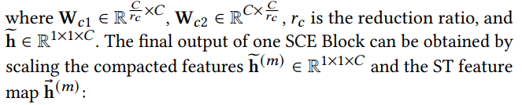

Channel Enhanced Module (CEM)

Slide 30
Residual learning module
Statistical methods have demonstrated robust prediction by removing trends and seasonality given time series data.
In light of these approaches, we introduce a similar concept to deep learning networks by devising a residual learning module to eliminate the sequential seasonality (i.e., periodicity).
It consists of two functions:
differencing function (DIFF)
fusion function (FUSE)

Slide 31


Differencing function
The hidden states of periodic closeness residual can be calculated by subtracting the hidden state of closeness h𝑥 from the hidden state of periodic closeness h𝑝𝑥 generated by ST Module:

Slide 32

Fusion function
where ∥ is the concatenation operation, and W_{𝑑} denotes learnable parameters. Therefore, the embedded vector H˜ ∈ R^{𝑃×𝐻×𝑊×𝐶} can represent the hidden states of the prediction residual, which are conditioned on the features of closeness residual and periodic prediction.
Notes:
https://www.twblogs.net/a/5c8bc5afbd9eee35fc14e044
https://keras.io/api/layers/merging_layers/concatenate/

Slide 33
External Module
External factors, such as date, event, and weather, can affect crowd flows.
The External (EXT) Module works on encoding these factors and outputs the external factor embedding E.

Slide 34

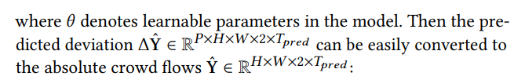

Decoder
The same form is for the Decoder. And the default Decoder of PRNet is a fully-connected layer (FC)
we define the loss function as:

Slide 35
EXPERIMENT
PERIODIC RESIDUAL LEARNING

Slide 36
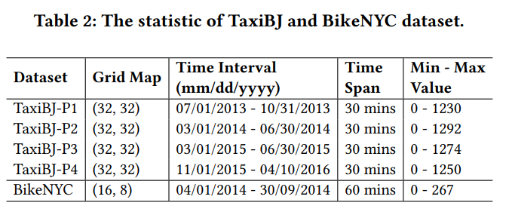
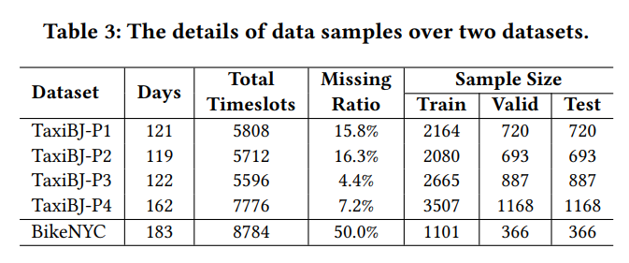
Statistic
we use a dictionary to store a default periodic value for each time slot and use it to fill the missing value.
We employ the last 20% data as the test set, and randomly select the remaining 60% data as the training set and 20% as the validation set, respectively.

Slide 37
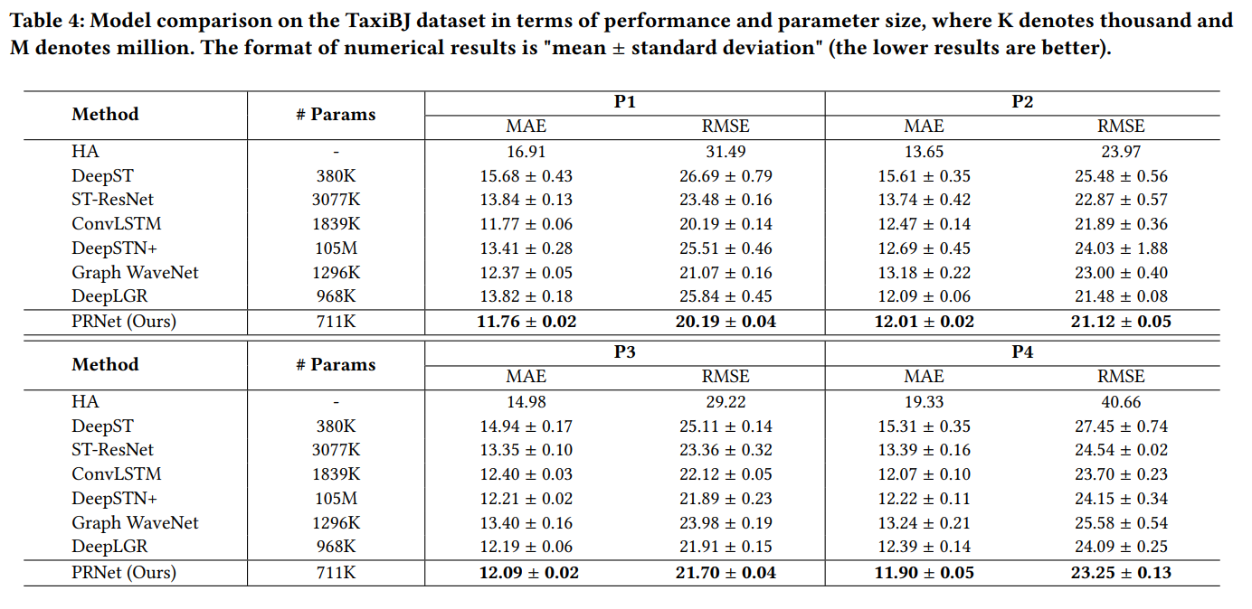
Model Comparison
Notes:
https://zh.wikipedia.org/wiki/%E5%B9%B3%E5%9D%87%E7%BB%9D%E5%AF%B9%E8%AF%AF%E5%B7%AE
https://zh.wikipedia.org/zh-tw/%E5%9D%87%E6%96%B9%E6%A0%B9%E8%AF%AF%E5%B7%AE
平均絕對誤差
均方根誤差

Slide 38
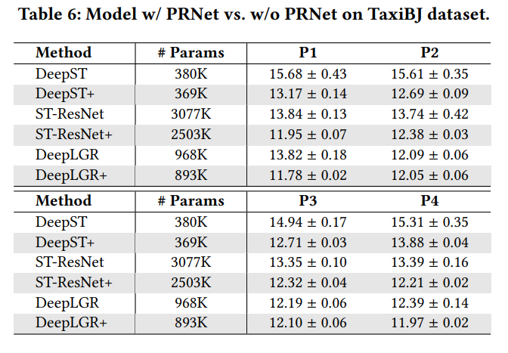
PRNet In these Model
The proposed structure assists them to reduce the MAE by 14.77%, 10.52 %, 5.13%, and to promote the robustness (i.e., reduce the standard deviation) by 76.92%, 80.25%, 63.64% on average on TaxiBJ dataset.

Slide 39
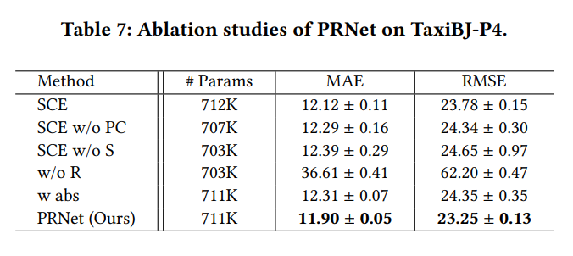
Ablation Studies of PRNet
SCE adopts a single SCE Encoder to encode the closeness, periodic closeness, and periodic predictions, which is equivalent to the PRNet without the periodic residual learning mechanism.
SCE w/o PC only adopts a single SCE Encoder to encode the closeness and periodic predictions.
SCE w/o S is SCE model without the Spatial Enhance Module (SEM).
w/o R is PRNet without the residual learning module, which utilizes seven shared parameters SCE Encoders to encode seven observed segments.
w abs uses PRNet to predict the absolute values rather than residuals.

Slide 40
Ablation Results
According to the results shown in Table 7, we can observe that:
1) Periodic closeness is important in prediction tasks.
2) Residual learning is essential for our model.
3) Enhancing spatial information boosts model performance.
- Our SEM provides the most salient features based on city-scale grids, which further promotes model performance.
4) Predicting the residual instead of absolute values leads to noticeable improvement, which proves our assumption about learning residual is much easier.

Slide 41
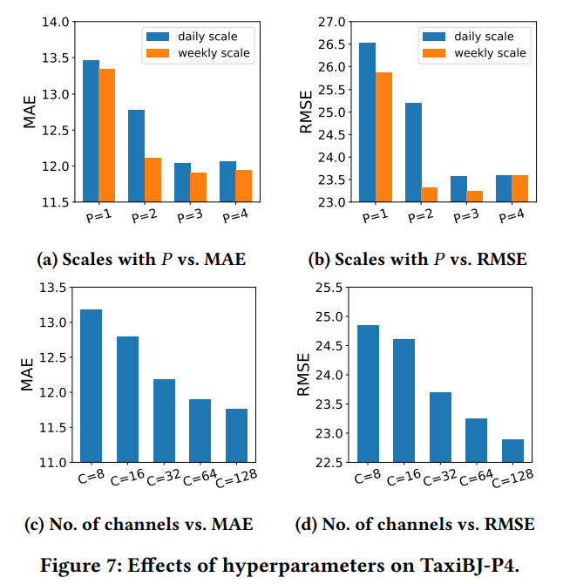
Effects of Hyperparameters

Slide 42
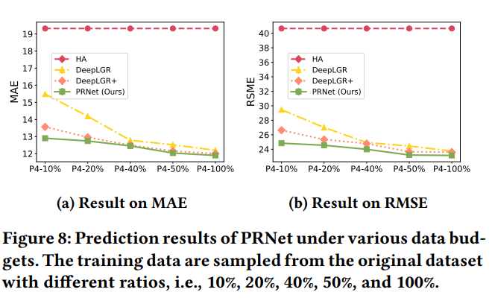
Prediction Results

Slide 43
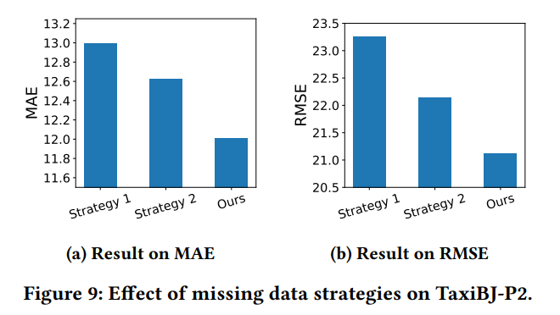
Strategy

Slide 44
Summary
We devise a simple yet effective periodic residual learning structure that learns the periodic residual at each time interval to improve the accuracy of multi-step ahead prediction. This structure can be easily integrated into existing models.
We introduce a lightweight Spatial-Channel Enhanced (SCE) Encoder to better capture global spatio-temporal dependencies.
Experiments on two real-world datasets demonstrate that PRNet surpasses the state-of-the-art approaches in long-term predictions. We also show that the periodic residual learning structure brings significant improvements in performance for existing models, especially under the small data budget.

Slide 45
IN THE END
PERIODIC RESIDUAL LEARNING

